Slide 1
Tofino Buffer Management

Slide 2
Tofino Packet Buffers
24MB of Packet Buffers on Tofino. Smallest unit is an 80B cell.
Buffer usage is controlled independently on ingress and egress
Ingress view of Buffers
Guaranteed minimum buffers for burst absorption (dedicated)
Shared buffer pools for burst absorption (up to 4)
1 Shared pool for PFC skid
Egress view of Buffers
Guaranteed minimum buffers for burst absorption (dedicated)
Shared buffer pools for burst absorption (up to 4)
PFC skid pool
EG Dedicated buffers
IG Dedicated buffers
EG Shared Pool-0
IG Shared Pool-0
EG Shared Pool-1
IG Shared Pool-1
IG Shared Pool-2
EG Shared Pool-2
Ingress Buffer View
Egress Buffer View

Slide 3
Buffer Management Control Points
PG (Port Group)
Control structure for buffer usage on the ingress
Each port has a default-PG
Optionally up to 8 PG can be mapped per port (limited by 256 PGs per pipeline) indexed by <ig_port, ig_cos(3b)>
Queue
Control structure for buffer usage on the egress
10G/25G ports: 8 queues
40G/50G ports: 16 queues
100G/CPU port: 32 queues
Ingress Buffer Pool Level Controls
Egress Buffer Pool Level Controls

Slide 4
PG Level Controls
Dedicated Guaranteed minimum buffers for PG’s traffic
PG’s traffic can be configured to use IG shared pool buffers once it has exhausted it’s dedicated buffers
Limits for PGs with PFC traffic mapped
PG’s usage limit for the PFC skid buffer pool
PG’s IG shared pool usage limit above which PAUSE is asserted for it’s traffic
PG’s IG shared pool usage below which PAUSE is de-asserted for it’s traffic
Limits for PGs with Non-PFC traffic mapped
PG’s IG shared pool usage limit before it’s packets are dropped
Shared pool usage limits can be configured either as static values or as a dynamic co-efficient υ <0..8>

Slide 5
Queue Level Controls
Dedicated Guaranteed minimum buffers for Queue’s traffic
Queue’s traffic can be configured to use EG shared pool buffers once it has exhausted it’s dedicated buffers
Queue’s EG shared pool usage limit before it’s packets are dropped
Shared pool usage limit can be configured either as static values or as a dynamic co-efficient υ <0..8>

Slide 6
Buffer Pool Level Controls
PFC Skid buffer pool size
For shared buffer pools used for burst absorption (IG and EG)
Pool type (PFC or Non-PFC)
Pool size
For Ingress shared Pools of type PFC
8 PFC (one per PRI) Xon/Xoff thresholds that track the total usage of the pool
If the pool’s PRI Xoff threshold is reached PFC is asserted to all PG’s of PRI that
Have packets in the pool AND
Still has packets arriving
When the usage of an Ingress shared pool of type Non-PFC is at 100% all PG’s that have packets in the pool start observing drops
When the usage of an Egress shared pool is at 100% all queues that have packets in the pool start observing drops

Slide 7
Tofino Buffer Management Configuration Example

Slide 8
Parameters used with example
Num 100G ports | 64
Num 50G ports | 0
Num 25G ports | 0
Num CPU queues | 32
Num Data-classes | 5
Num PFC-classes | 2

Slide 9
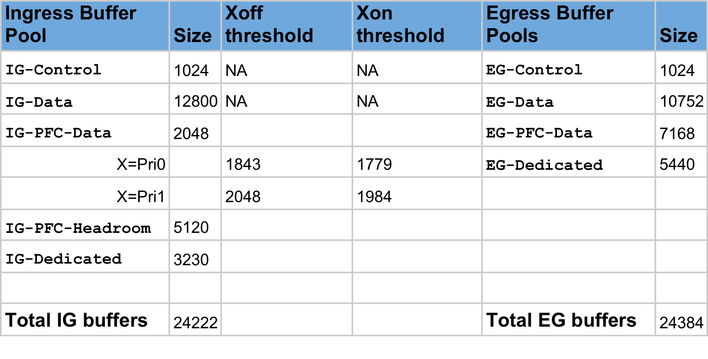
Buffer Pool Level Configuration
*All values in units of KB

Slide 10
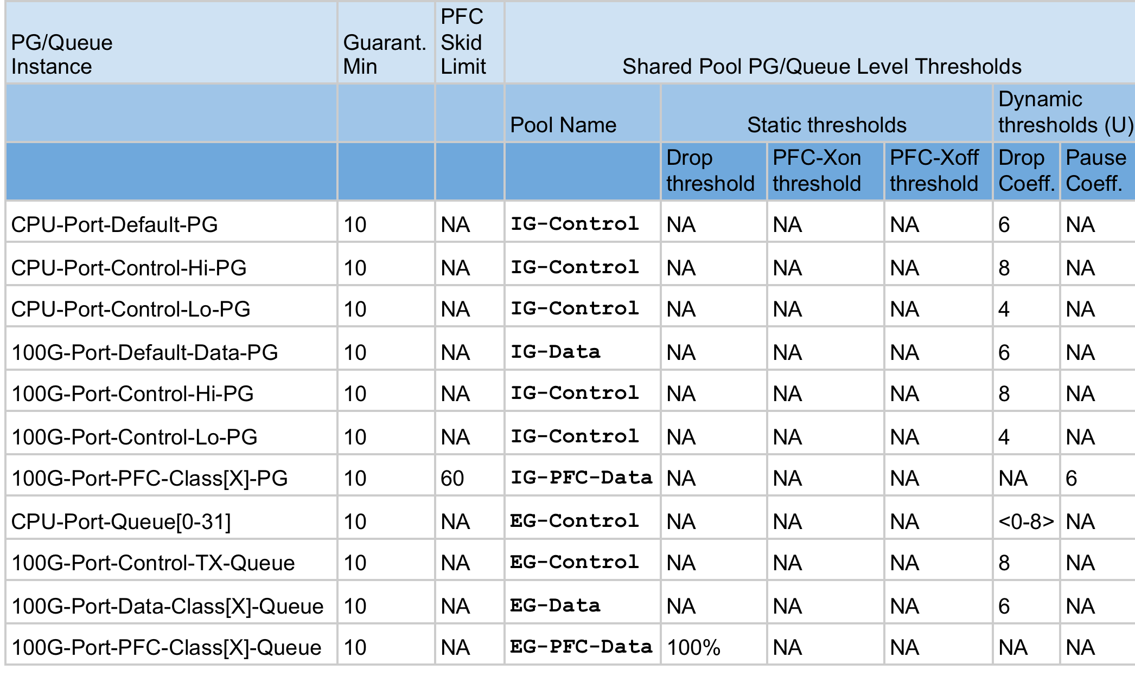
PG and Queue Level Configuration

